Slide 1
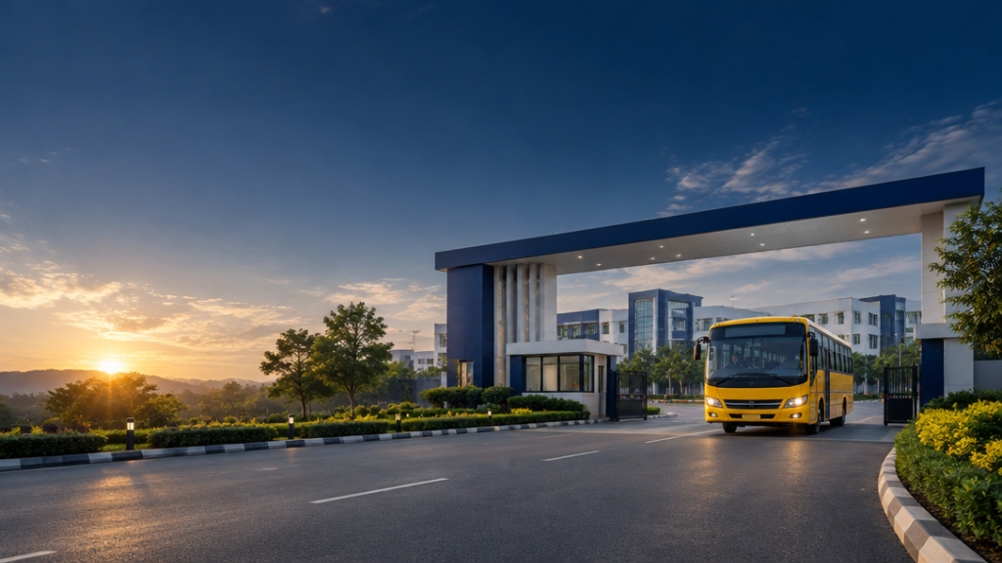
SMARTBUS
GATE TRACKER
College Bus Entry, Exit and GPS Journey Monitoring System
PRASANNA K
240701396
Rajalakshmi Engineering College, Thandalam, Chennai
Department of Computer Science and Engineering

Slide 2
ABSTRACT
A digital transport-management solution integrating campus gate entry/exit recording with GPS journey monitoring in one clear operational view.
120+
BUS RECORDS
1
Centralized digital fleet records
2
Camera-assisted plate recognition
3
Shift-wise schedule validation
4
Evening GPS journey monitoring
5
Sample records + simulated GPS in prototype

Slide 3
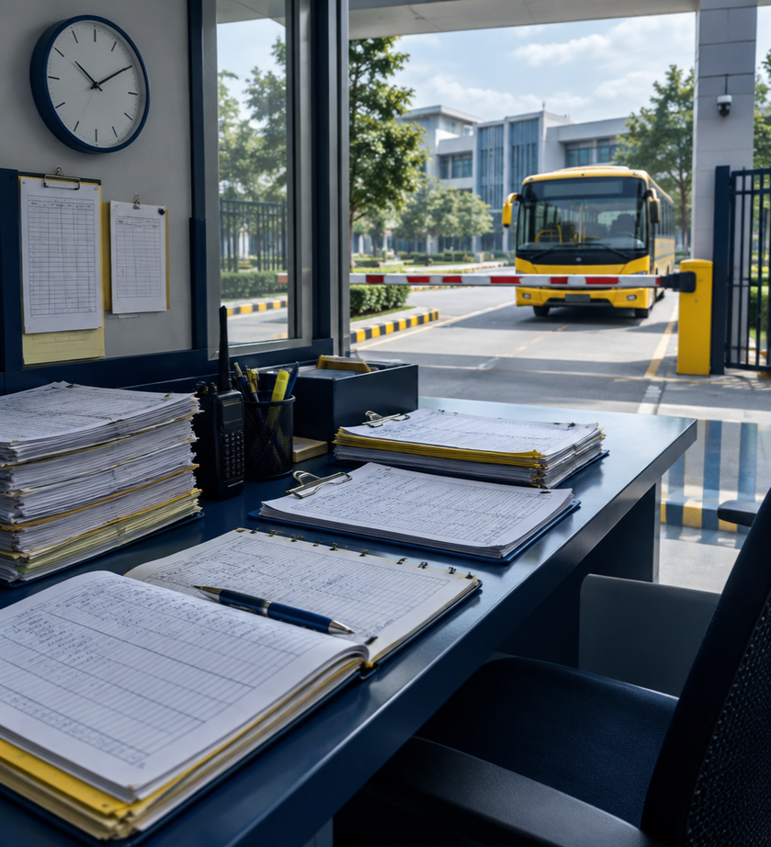
PROBLEM STATEMENT
— Manual records are difficult to maintain
— Gate identification creates avoidable delays
— Schedule comparison is time-consuming
— Evening journeys lack visibility
— Routes, stops and assignments are hard to retrieve
— Location and schedule data remain fragmented

Slide 4
OBJECTIVES
1
2
3
4
CENTRALIZE
bus + driver data
SCALE
120+ buses
ORGANIZE
shifts + routes
IDENTIFY
plates by camera
5
6
7
VALIDATE
entry + departure
TRACK
evening journeys
REPORT
destination arrival

Slide 5
EXISTING SYSTEM / PROPOSED SYSTEM
EXISTING / MANUAL
SMARTBUS GATE
× Distributed transport details
✓ Centralized bus + route records
× Manual gate-time recording
✓ Camera-assisted plate ID
× Separate route lookups
✓ Automatic schedule comparison
× Manual journey tracking
✓ GPS journey monitoring
× Manual report compilation
✓ Searchable reports + dashboard
General system-design comparison — not an audit of REC’s current system.

Slide 6
TECHNOLOGY STACK
MAIN LANGUAGES
SUPPORTING TOOLS
HTML5 • structure
Vite • dev + build
CSS3 • responsive styling
Tesseract.js • OCR
JavaScript • validation + events
Leaflet + OpenStreetMap • maps
React.js • UI components
JSON + localStorage • prototype data

Slide 7
SYSTEM ARCHITECTURE
INPUT LAYER
Gate camera • bus & driver data • routes & shifts • GPS feed
PROCESSING LAYER
Frame capture → OCR normalization → bus match → schedule validation → geofence
APPLICATION LAYER
Homepage • fleet • routes • entry/exit monitoring • tracking • analytics
DATA LAYER
JSON datasets • browser localStorage • GPS history • event records

Slide 8
MAIN MODULES
DEMO DATA • CONCEPTUAL UI
DEMO DATA • CONCEPTUAL UI
DEMO DATA • CONCEPTUAL UI
Transport homepage
& achievements
Fleet + shift-wise
bus details
Routes + ordered
stopping points
DEMO DATA • CONCEPTUAL UI
DEMO DATA • CONCEPTUAL UI
DEMO DATA • CONCEPTUAL UI
Standing-location
management
Morning entry +
evening departure
GPS journey +
destination arrival
Fleet dataset includes 120+ fictional demo buses.

Slide 9
BUS FLEET & ROUTE MANAGEMENT
Fleet records separate bus number, registration, driver, route, shift and schedule — with ordered stopping points for every route.
EXAMPLE ROUTE • DEMO DATA
BUS 1A
Porur → College
Departure: 6:40 AM
Scheduled arrival: 7:40 AM
Driver: Demo Driver A
Bus nos. 1, 1A, 17, 17C
Morning: 8:00 / 10:00 AM
Evening: 3:00 / 5:00 PM
Registration + driver details
Origin → destination
Ordered stopping points

Slide 10
AUTOMATIC NUMBER PLATE RECOGNITION
CAMERA
frame capture
OCR
Tesseract.js
NORMALIZE
registration
LOOKUP
registered bus
VALIDATE
schedule
RECORD
entry event
Browser camera API • text extraction • registration matching • bus + driver identification
RELIABILITY CONTROLS
Confidence review / repeated-frame duplicate detection / unregistered vehicle warning
OCR accuracy varies with lighting, plate visibility, angle and image quality. Tesseract.js is an initial approach requiring enhancement for production reliability.

Slide 11
MORNING ENTRY / EVENING DEPARTURE
MORNING ENTRY
EVENING DEPARTURE
Records campus entry • compares scheduled arrival • displays bus, driver, route and timestamps
Records campus exit • compares scheduled departure • starts GPS journey tracking
DEMO DATA
7:40 scheduled / 7:36 actual
ON TIME
DEMO DATA
4:00 scheduled / 4:12 actual
LATE
GREEN = at/before schedule RED = after schedule WARNING = unregistered REVIEW REQUIRED = uncertain OCR

Slide 12
GPS JOURNEY TRACKING & DESTINATION ARRIVAL
Exit confirmed
↓
GPS updates
↓
Bus moves on route
↓
Geofence reached
↓
Arrival recorded
DEMO GPS
IN TRANSIT • GPS STALE • ARRIVAL UNCONFIRMED
ARRIVED ON TIME • ARRIVED LATE
Campus gate camera alone cannot confirm destination arrival; an authorized GPS device/feed is required.

Slide 13
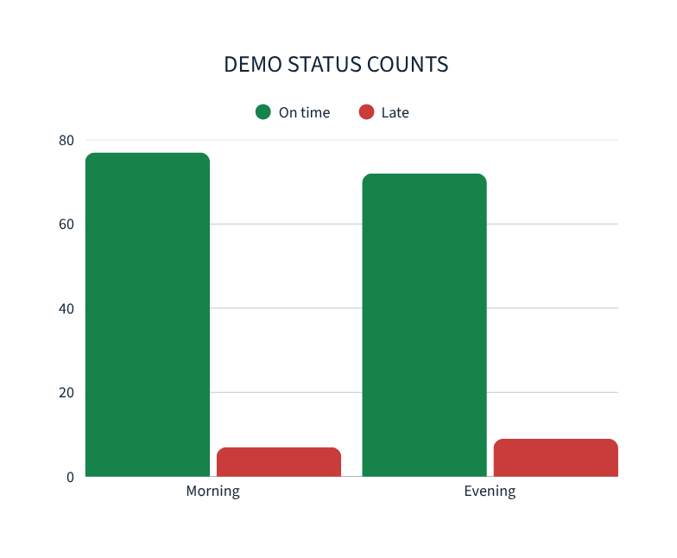
DASHBOARD, REPORTS & SAMPLE OUTPUT
120
84
7
81
9
12
69
Registered
Morning entries
Late AM
Evening exits
Late PM
In transit
Arrived
DATE BUS REG. NO. DRIVER ROUTE SCHEDULE ACTUAL STATUS
12 Mar 1A TN-XX-0001 Demo Driver A Porur 7:40 AM 7:36 ON TIME
12 Mar 17C TN-XX-0017 Demo Driver B Avadi 4:00 PM 4:12 LATE
12 Mar 1 TN-XX-0002 Demo Driver C Tambaram 7:45 AM 7:43 ON TIME
Illustrative values computed from DEMO DATA records.

Slide 14
TESTING, LIMITATIONS & FUTURE ENHANCEMENTS
TESTING
CURRENT LIMITATIONS
FUTURE
• Registration search + validation
• Demo records are not official
• Actual bus GPS integration
• Route and schedule lookup
• Simulated GPS is not live
• Secure role-based database
• Arrival / departure validation
• localStorage is browser-specific
• Dedicated plate detection
• OCR confidence + duplicate scans
• OCR may need human review
• Real-time late notifications
• GPS simulation + geofence
• Background GPS needs infrastructure
• Student information portal
• Persistence + report export
• Multi-device analytics

Slide 15
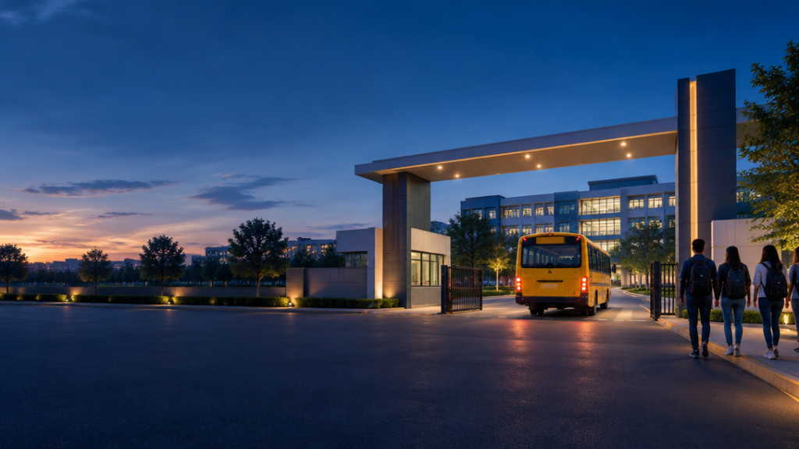
SMARTBUS GATE
One portal for fleet data, routes, camera-assisted identification, schedule validation and GPS journey monitoring.
Faster gate identification • organized records
Automatic time comparison • improved journey visibility
Searchable reports • foundation for real-time integration
THANK YOU

